Slide 1
eLFA 2018
Advancement and Research Trends of Game-based Learning Studies
In The Rich-Technology Era
Student：
Qing-Ke Fu
Supervisor：
Gwo-Jen Hwang
May 23, 2018

Slide 2
Introduction
Owing to digital revolution, calling for education reform is ongoing. Technology-based learning is an effort to respond to it (Collins & Halverson, 2009) .
Game-based learning (GBL).
Continuous exploration of the nature of learning, diverse learning theories have been proposed (Rennie & Johnston, 2004), which been used and examined in plenty of game-based learning practices (Wu, Chiou, Kao, Hu, & Huang, 2012).
Periodically reviewing the literature on game-based learning is beneficial and desired (Dempsey, Rasmussen, & Lucassen, 1996; Hays, 2005; Wu, Chiou, Kao, Hu, & Huang, 2012).
To investigate the development and trends on GBL studies published from 1997 to 2016.

Slide 3
Method
("game" or "gaming" or "gamification") and ("learning" or "education")
_________________________________________________________
Scopus database
1997 - 2016
32283 papers
___________________________________________
Inclusion criteria
To examine the advancement and research trends of GBL studies
from the macro view

Slide 4
Results
1
Advancements and trends
Figure 1. Number of GBL articles published from 1997 to 2016

Slide 5
Results
1
Advancements and trends
Leisure-oriented to learning-oriented
(Boyle, Connolly & Hainey, 2011).
Behaviorism, cognitivism to constructivism.
(Rugelj,2015; Wu et al., 2012).
Decontextualized environment to authentic learning environments (e.g., Museum, ecological garden, historical spots).
GBL to innovative GBL, such as context-aware ubiquitous game learning (Liu & Chu, 2010), inquiry-based ubiquitous gaming learning (Hwang & Chen, 2016), reality-based game learning (Hwang, Wu, Chen, & TU, 2015), etc.
Technological development
GBL
practices
Educational game
Figure 2. The reason for advancement

Slide 6
Results
2
Major contributing countries
Figure 3. Major contributing countries/regions of GBL articles from 1997 to 2016

Slide 7
Results
2
Major contributing countries
Technological development
Video game industry
In America
GBL
practices
Educational game
GBL
practices
Digital natives
The video game industry has been booming for decades (Becker, 2017) .
Playing games is commonplace among a range of demographic groups (Ryan, Rigby, & Przybylski, 2006).
Association for Educational Communications Technology (AECT, 2014) reported that more than half of teachers used video games in class at least one time per week.

Slide 8
Results
2
Major contributing countries
Taiwan contributed the most to the growth between the first and second 10 years
Out of top 15
Top 7

Slide 9
Results
2
Major contributing countries
The experience of GBL practices in Taiwan
Sensitive perceptions towards the potential of technologies
Inter-universities GBL community
in Taiwan
Conducting
Innovative learning approaches and practices
e.g.,
Game-based
mobile learning

Slide 10
Results
3
Subject disciplines

Slide 11
Results
4
Authors’ contribution
Table 1 Authors with the top 10 contributions from 1997 to 2016

Slide 12
Results
4
Authors’ contribution
1
Prof.
Tak-Wai Chan
Dr.
Thomas Hainey
2
Prof.
Baltasar Fernández-Manjón
Digital GBL
Mobile learning
3
Mobile GBL
Pedagogical agent
assessment integration for GBL applications
Learning analytics
Technology-assisted mathematic and language learning
evaluation of GBL applications
Learning standard
Serious game
design & implementation
Motivation for playing game
E-learning

Slide 13
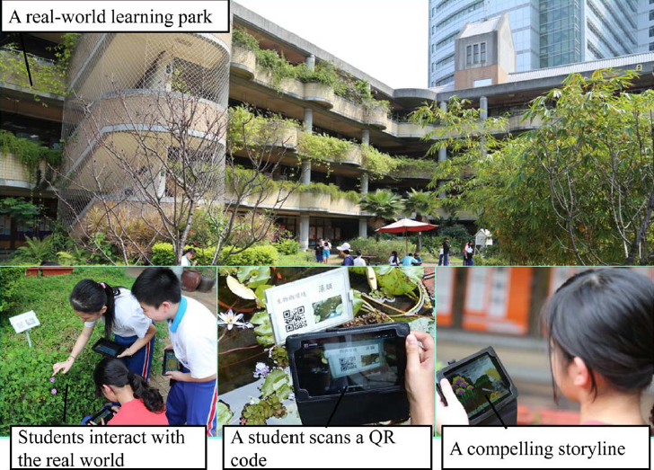
Conclusion
4
game-based mobile learning could be the development trend
Behaviorism
cognitivism
constructivism
Learning strategy
Innovative learning strategy
PC
Mobile device
Wearable device
classroom
Real-world contexts
Formal & informal
e.g. an inquiry-based ubiquitous gaming
(Hwang, Chen, 2016)
Learning gain
Learning process analytics
Experience of GBL practices in Taiwan

Slide 14
THANKS

